Slide 1


SpartanGPT
A wanna-be clone of ChatGPT
Presented By: Harshith Uppula | Harsimran Kaur | Mounica Ayalasomayajula | Richa Sharma | Shwetarani

Slide 2
PROJECT GOAL AND MOTIVATION
Our project's objective is to develop a thorough understanding of the GPT-2 architecture in order to reproduce it and create SpartanChatGPT, a scaled-down version.
On a specific dataset, it will be possible to train and test this version, which will produce responses that are appropriate for the context and tone of the conversation.
The method entails optimizing the pre-trained GPT-2 model using a unique dataset created by San Jose State University (SJSU).
The model's performance will be evaluated, and the result will be the development of appropriate conversational responses.
Notes:
1.The project's goal is to obtain an in-depth understanding of the existing GPT-2 architecture and replicate and build a clone of the ChatGPT model called SpartanChatGPT at a smaller scale that is feasible to train and test on a targeted dataset.
2)The approach for this is by fine-tuning the pre-trained GPT-2 model on the custom data of SJSU and evaluate the model’s performance and achieve the end result of generating responses for the conversations.

Slide 3
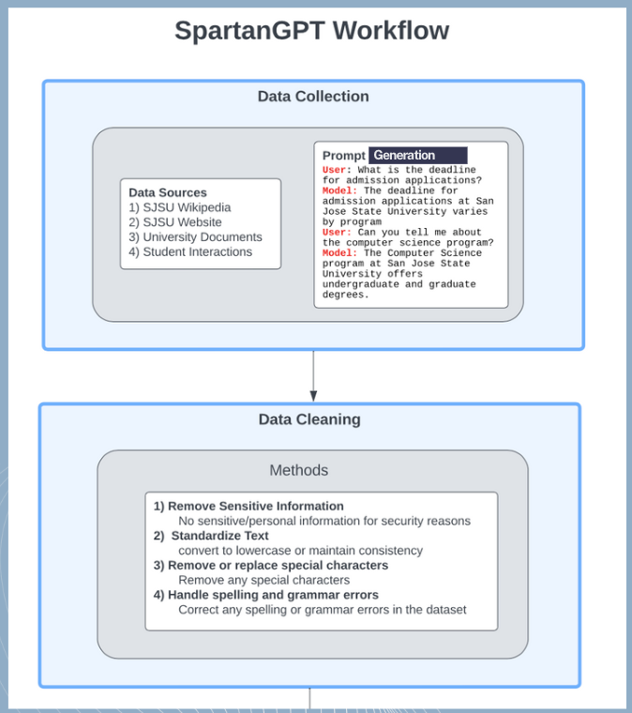
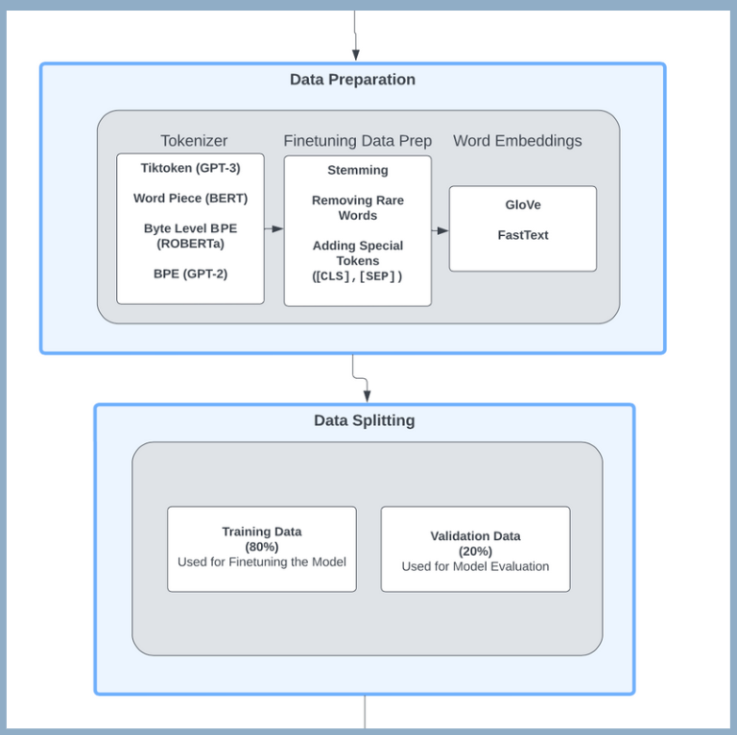
PROJECT ARCHITECTURE

Slide 4
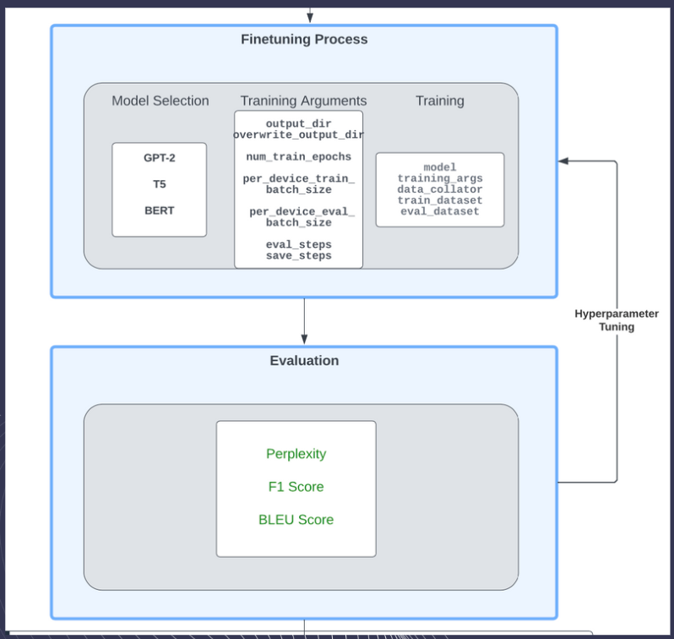
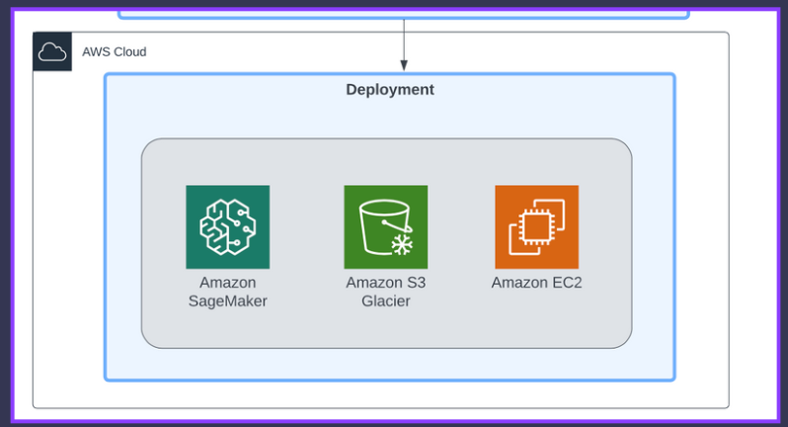
PROJECT ARCHITECTURE

Slide 5
Data Pre-Processesing Steps
1
Data Cleaning
2
Data Transformation
3
Splitting Data
4
Tokenization
5
Data Preparation for Fine tuning the model.

Slide 6
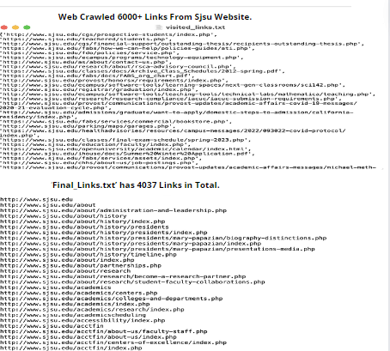
Data Collection
The collected data includes URLs of visited pages, webpage content, and links to other webpages which were around 6000+ links overall as shown in figure.
Then we clean the collected links file and remove the duplicates i.e. one link with http and the same link with https, unnecessary extension links i.e. ones having pdfs, and so on which drops the count of overall collected links to 4037 as shown in figure which we scrape to get the text data as required for the project.
Notes:
1)We used a Python script for data collection that defines a function named
"crawl_website".
2)This function takes four parameters: "url", "visited", "max_depth", and
"encoding".
3)It crawls a website recursively, keeps track of all visited pages, and writes the URLs
to a file named "visited_links.txt".
4)The collected data includes URLs of visited pages, webpage content, and other webpages links, hence we overall collected
6000+ links as shown in the 1st fig.
5)Then we cleaned the
collected links file by removing the duplicates, i.e. one link with http and the same link with https,
and at last, we collected to 4037 links as shown in figure2.And after extracting these links we got our final raw data in the form of Txt files as per our project requirement.

Slide 7
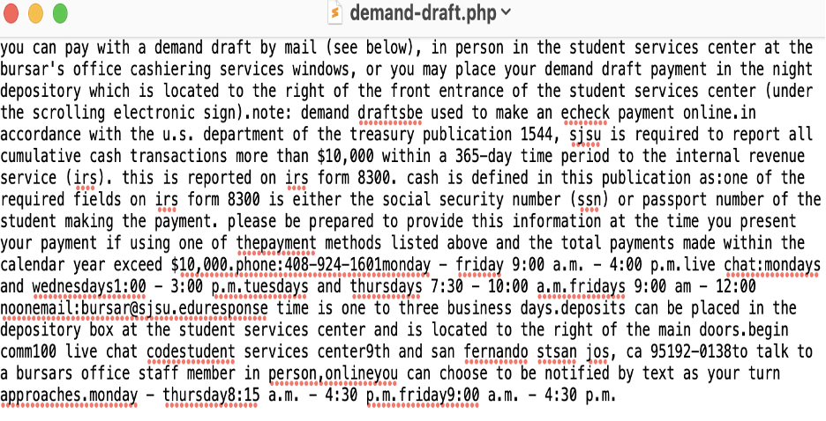
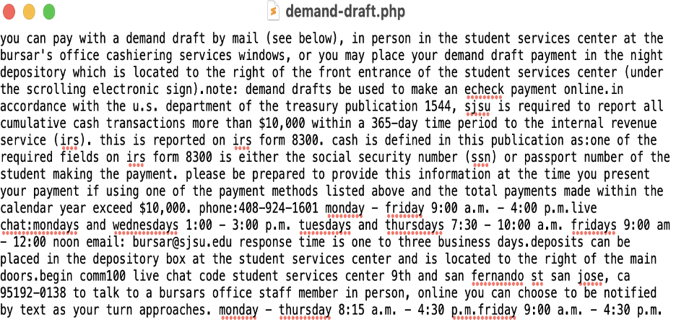
Data Cleaning
Raw Dataset After Scraping
Remove all irrelevant or noisy data such as special characters, URLs, HTML tags, etc. Performs basic text normalization. Convert text to lowercase and remove punctuation.
Convert all text to lowercase, Remove consecutive whitespace characters, Remove HTML elements such as script and style tags, header and footer tags, and links, Remove the COVID-19 alert div if it exists on the page, Encode the text in ASCII to remove non-ASCII characters, Write the cleaned text to a file, without any newlines or extra whitespace
Data After Cleaning
Notes:
1. Converted all text to lowercase
2. Removed consecutive whitespace characters
3. Removed HTML elements such as script and style tags, header and footer tags, and links
4. Removed the COVID-19 alert div if it exists on the page
5. Encoded the text in ASCII to remove non-ASCII characters
6. Wrote the cleaned text to a file, without any newlines or extra whitespace.

Slide 8
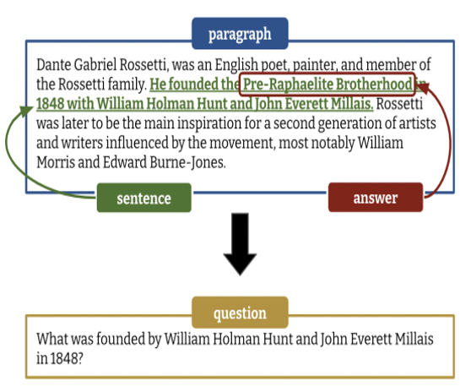
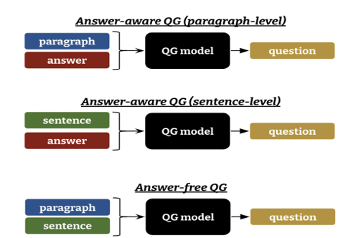
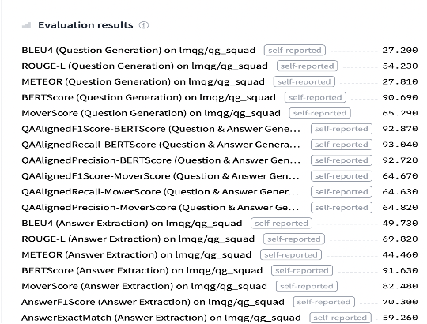
Overview of Paragraph-Level QG
Variations of QG Models' Inputs
Data Transformation- LMQG Model
Evaluation Metrics Used by Model T5 on HuggingFaces.
Notes:
1)We have used HuggingFaces Transformers library to generate questions and answers downstream tasks.
2)we have written a python script using the model ‘lmqg/t5-large-squad-qg-ae’ from HuggingFaces .
3)The code first loads a pre-trained tokenizer and model using the AutoTokenizer and AutoModelForSeq2SeqLM classes from the Transformers library.
Then, for each file in the input folder, it reads the text from the file and splits it into sentences using regular expressions.

Slide 9
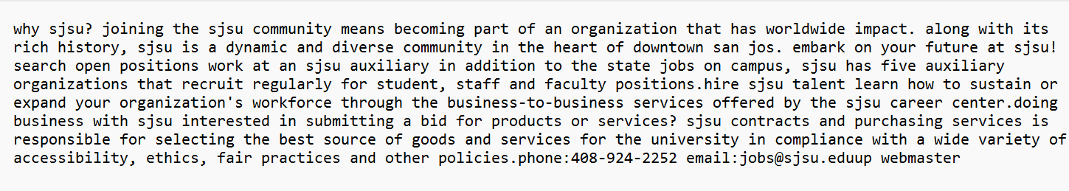
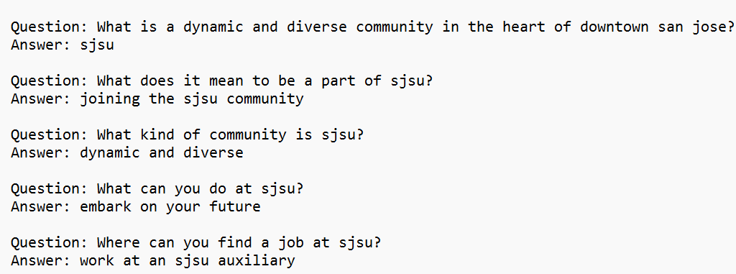
Data Transformation- LMQG Model
Raw Data
QA-Prompt Example 1

Slide 10
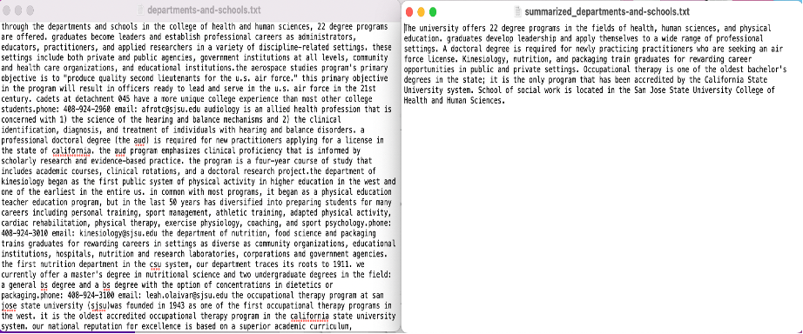
Data Transformation- Textsum Model
Raw Data
Summarized Data
Notes:
Summarization:
1)Textsum- This package provides easy-to-use interfaces for using summarization models.
2)easily summarizes text-based files with transformers.
3)This is one of the popular fine tuned model available on hugging faces which uses libraries AutoModelForSeq2SeqLM, AutoTokenizer of transformers for summarization downstream task.
4)it's one of the important feature is , it's implementation approach wherein it offers three ways to use this package: python API, CLI, Demo App
So this can be used in standalone tasks .

Slide 11
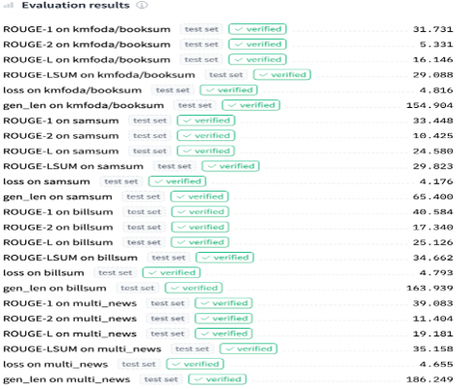
Data Transformation- Textsum Model
Evaluation Metrics of Textsum on HuggingFaces

Slide 12
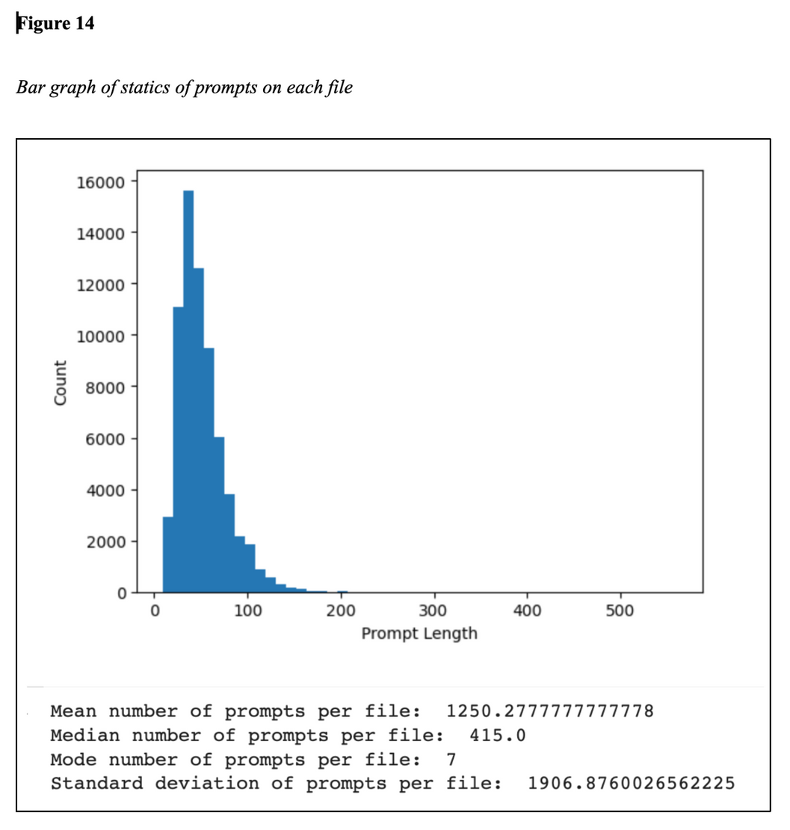
Data Analytics
Statistical analysis helps find patterns, correlations, and trends in the data.
Distribution of Statistics of Prompt:
This insight can guide decisions on model architecture and token limitations, ensuring that the ChatGPT model is capable of handling prompts of varying lengths effectively.

Slide 13
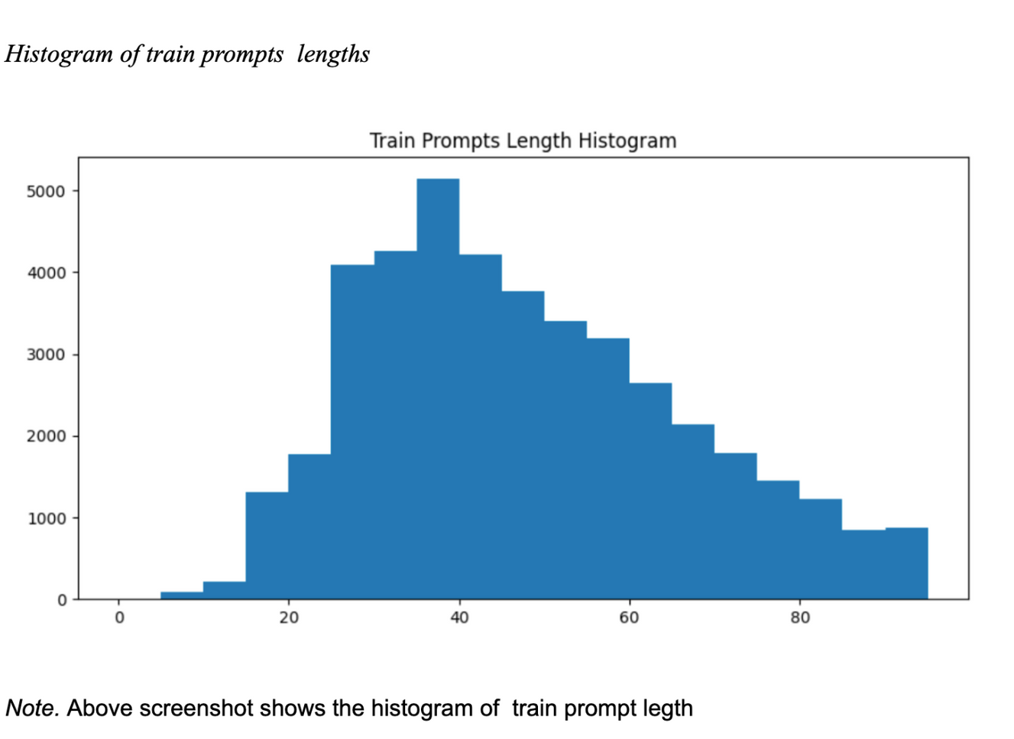
Data Analytics
Statistical analysis helps find patterns, correlations, and trends in the data.
Distribution of Prompt Lengths:
Give an understanding of the sequence length and size of the context that is usually preferred for the model

Slide 14
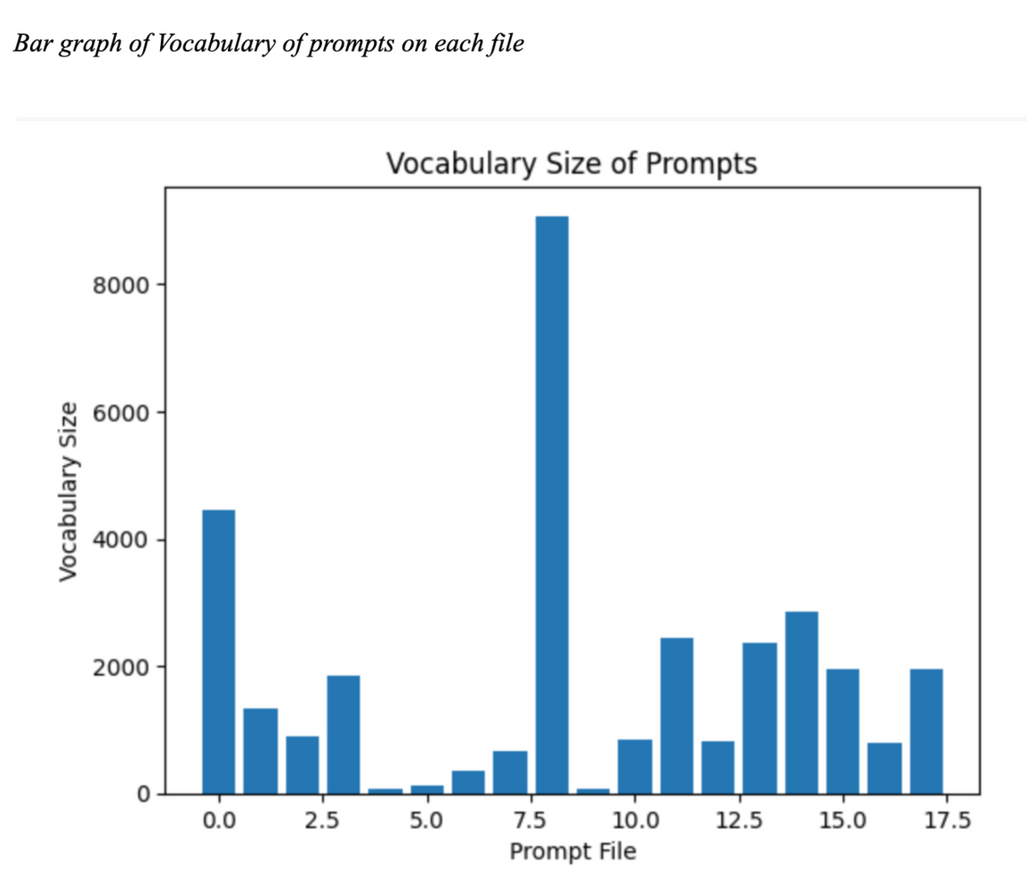
Data Analytics
Statistical analysis helps find patterns, correlations, and trends in the data.
Vocabulary Size and Lexical Complexity:
A larger vocabulary size indicates a wider range of topics and higher linguistic complexity.
Counting distinct words helps understand the language used in prompts and guides language model creation.

Slide 15
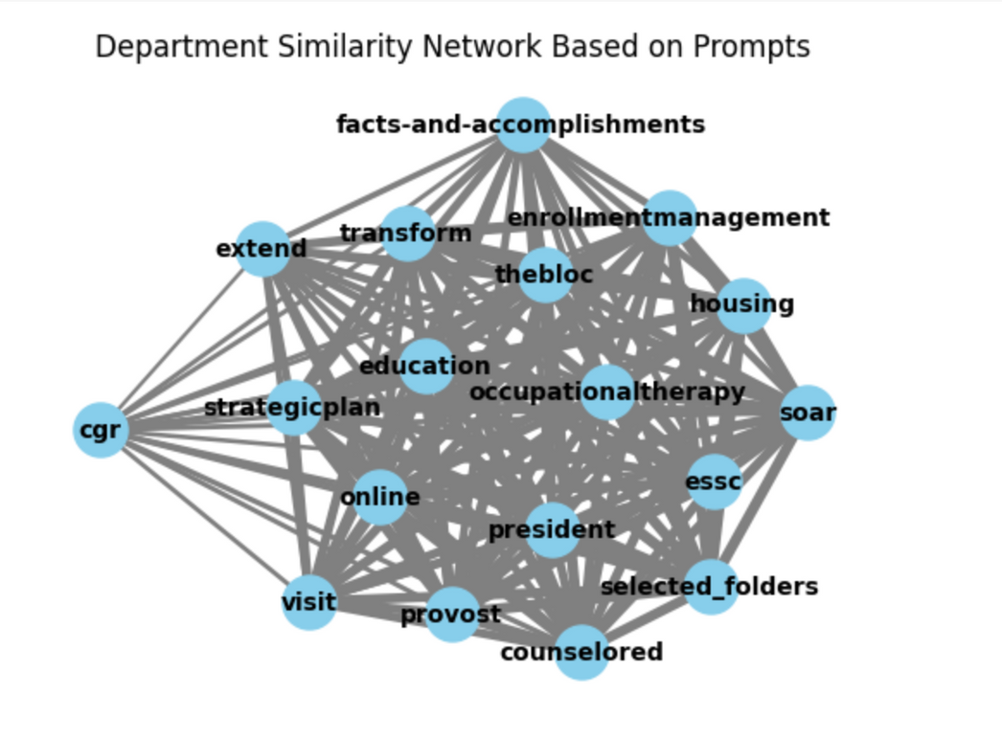
Data Analytics
Process of examining and interpreting data to extract valuable insights and inform decision-making.
The graph illustrates department connections.
Closely linked departments share similar prompt content, the model can be fine-tuned to differentiate between them and provide specialized responses.

Slide 16
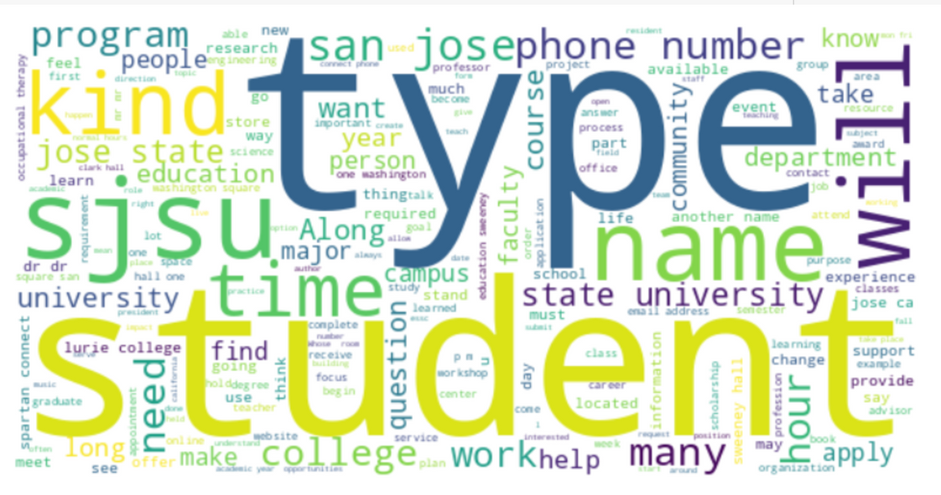
Data Analytics
Process of examining and interpreting data to extract valuable insights and inform decision-making.
Creating a Word Cloud from SJSU-related prompts
"Student" and "SJSU" imply high student engagement from San Jose State University.
Frequent use of "Engineering" indicates a focus on engineering-related topics.
"Type" requires context to understand its relevance.
Mentions of "Time" suggest time-related queries, such as scheduling and deadlines.

Slide 17
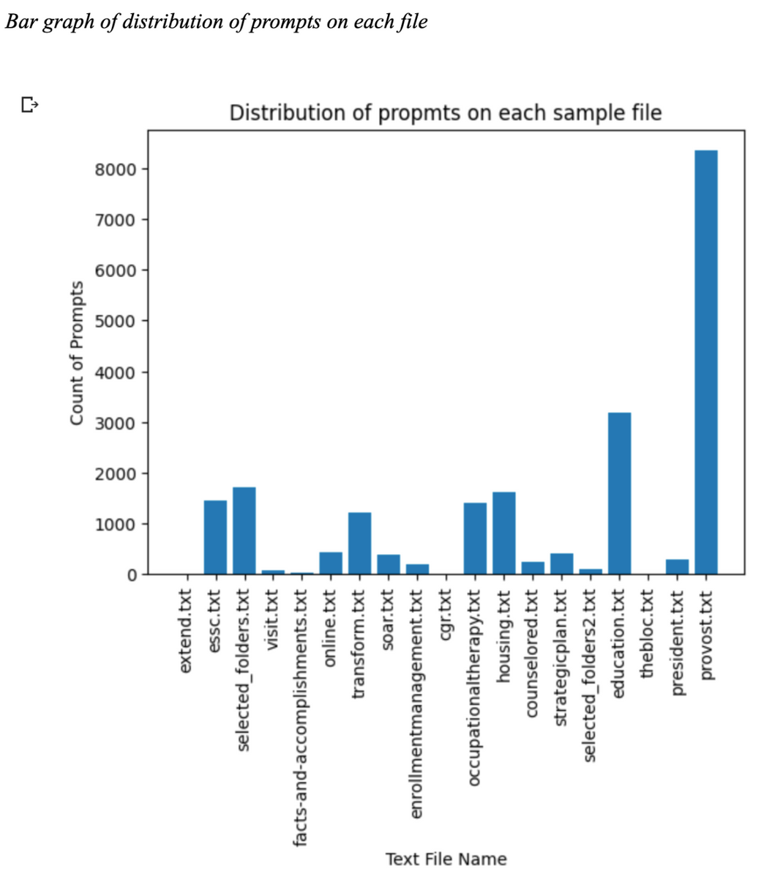
Data Analytics
Statistical analysis helps find patterns, correlations, and trends in the data.
Distribution of Prompts in Text Files:
Uneven distribution may lead to overfitting on files with more prompts and underfitting on files with fewer prompts.
Stratified sampling can be applied to ensure representative samples from each file during cross-validation.
Notes:
whatever we visualized in this plot, we got to know that each file has uneven distribution of Question and answers.

Slide 18
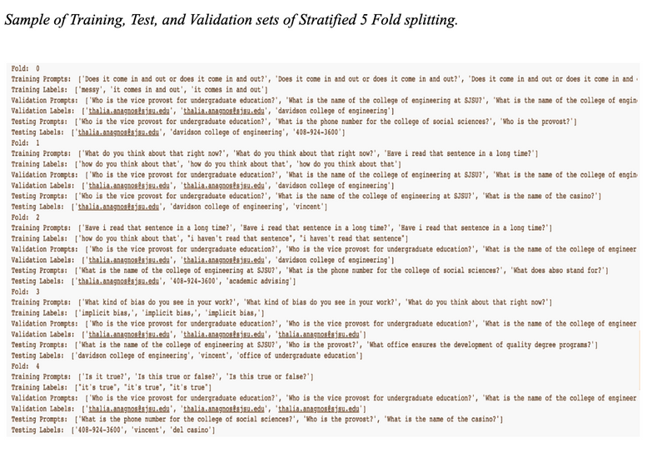
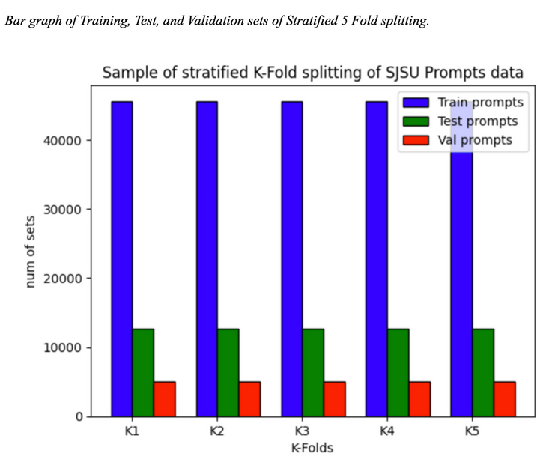
Data Preparation
Training, Validation, and Test Datasets:
Stratified k-fold sampling is considered to split the data into training, validation, and test datasets.
Stratified sampling ensures each fold has a representative sample of the SJSU department prompts.
Benefits of Stratified K-fold sampling:
Each fold has a representative sample from each dept.
Provides a more accurate estimate of the model's performance by repeating the k-fold cross-validation procedure.
Helps avoid overfitting and improves the model's generalizability
Notes:
For dividing test and train datastes we are using stratified Kfold sampling.
What stratified does it to make sure each fold should have every department data.
So this helps to avoid overfitting and improves model generalizability.

Slide 19
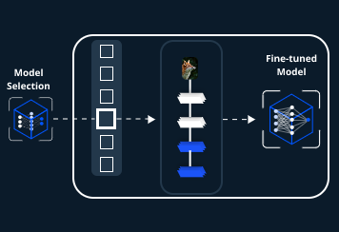
Finetuning
Fine-tuning is the process of slightly adjusting the parameters of a pre-trained model, which has learned useful features from a large-scale dataset, to perform well on a specific task. This process effectively allows us to leverage and adapt the generalized language understanding capabilities of the pre-trained model to our specific use case, optimizing the model's parameters to minimize the error in our task-specific data.

Slide 20
T5
DialoGPT
Machine learning model selection and justification
BERT
RoBERTa
GPT-2
Bloom

Slide 21
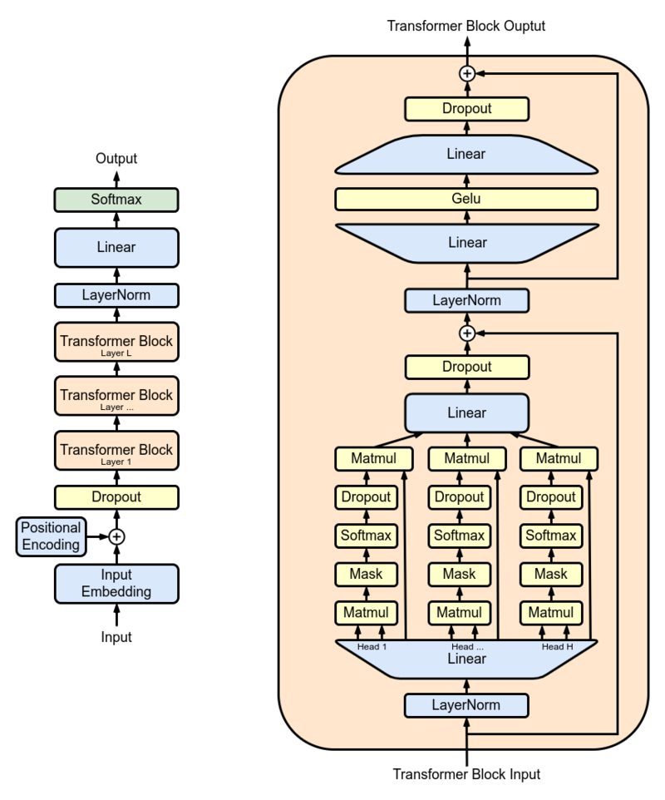
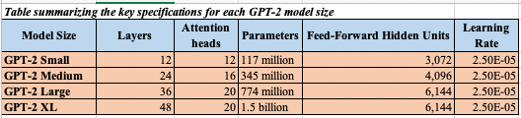
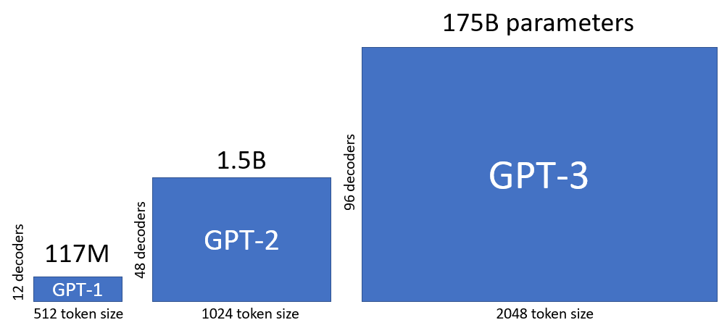
GPT-2 (Generative Pretrained Transformer)
Notes:
1)GPT-2 uses a transformer architecture, which consists of multiple layers of self-attention mechanisms and feedforward neural networks. This architecture allows it to capture contextual information in text efficiently.
2)t's autoregressive nature generates text step by step, and it can be fine-tuned for various natural language processing tasks.
3) Various model variants: small,medium,large,xl

Slide 22
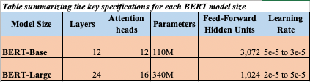
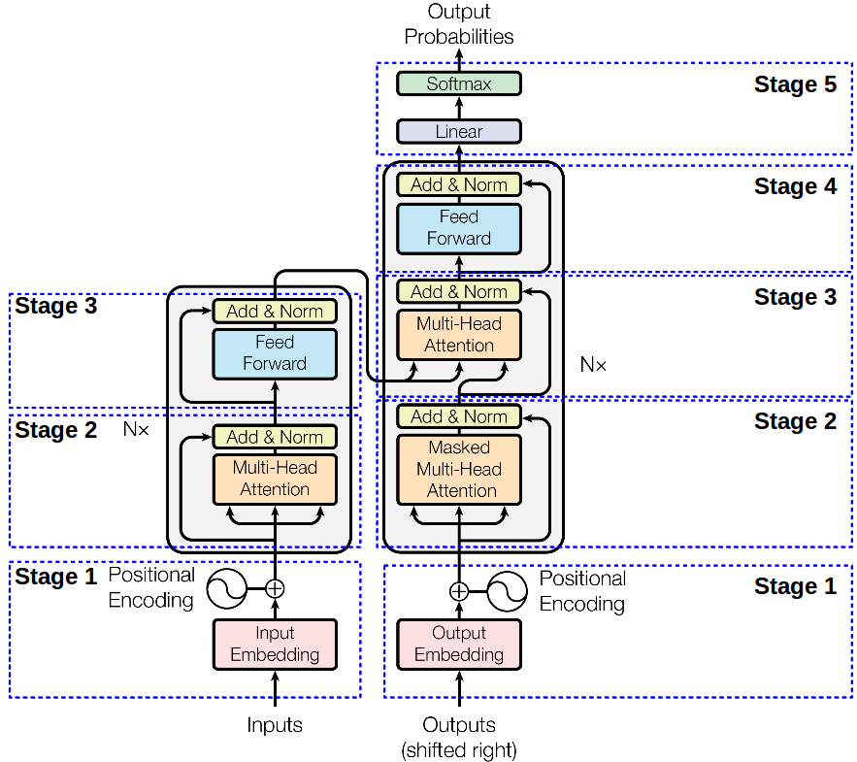
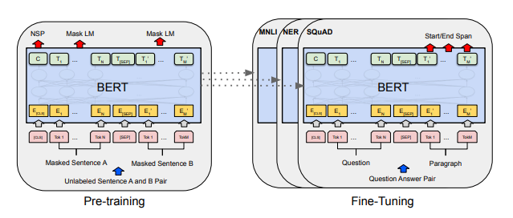
BERT (Bidirectional Encoder Representations from Transformers)
Notes:
1)Unlike earlier models, BERT considers both left and right context when processing words in a sentence. This bidirectional understanding of context improves its ability to capture nuanced language patterns.
2)It is pretrained on a massive corpus of text data in an unsupervised manner. This pretraining phase helps it learn rich language representations, making it versatile for fine tuning a wide range of natural language understanding tasks.
3) Model variants

Slide 23
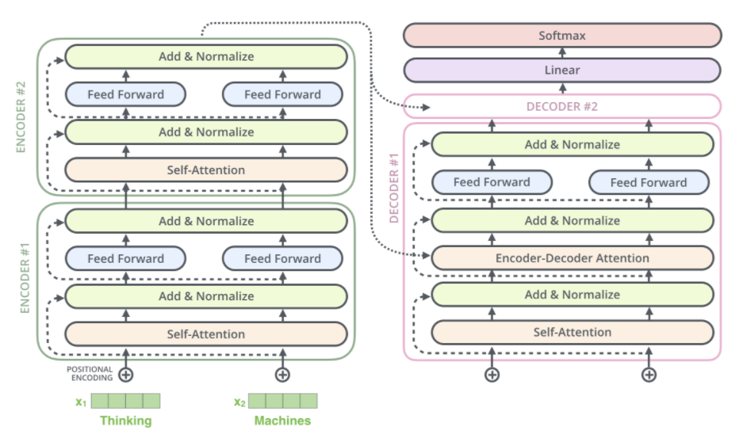
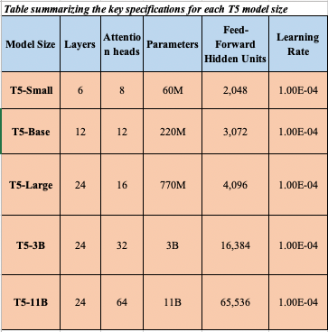
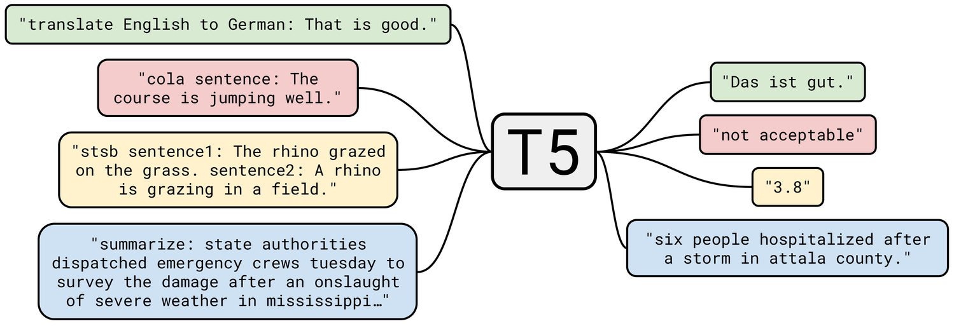
T5(Text-to-Text Transformer)
Notes:
1)a versatile language model that approaches all natural language processing tasks as a text-to-text problem.
2)It employs a transformer architecture, where both input and output are treated as text sequences, enabling it to handle a wide range of NLP tasks, from translation and summarization to question answering and text generation.
3)Model variants

Slide 24
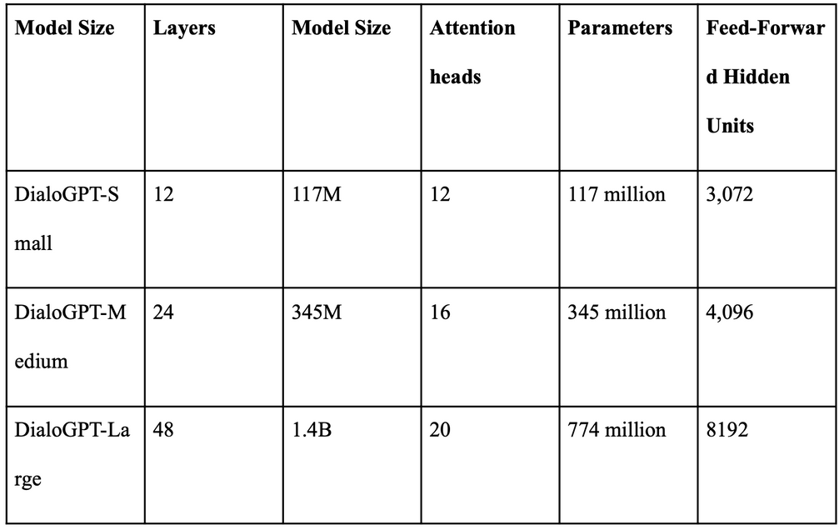
DialoGPT
Notes:
1)a conversational AI model designed for natural language understanding and generation in dialogue scenarios, making it suitable for chatbots, virtual assistants, and other interactive applications.
2)It's trained to engage in coherent and contextually relevant conversations by leveraging a large pretraining dataset and autoregressive generation techniques.
3)Model variants

Slide 25
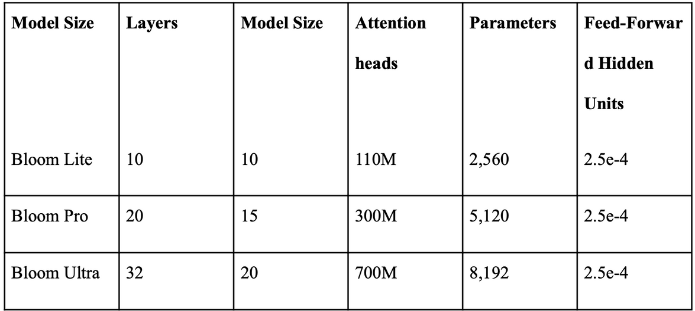
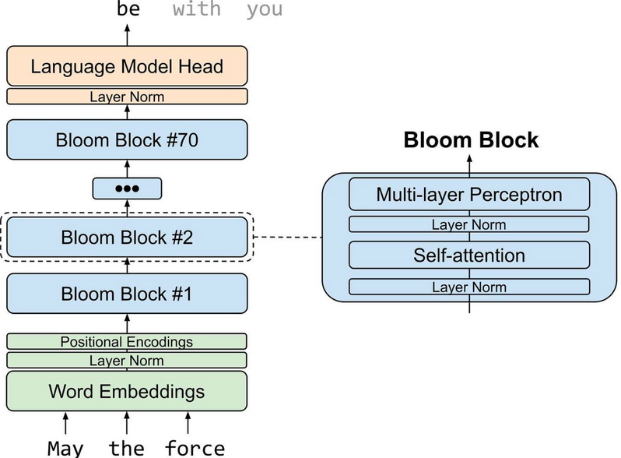
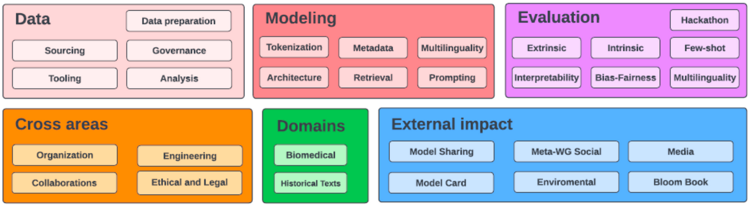
Bloom
Notes:
1)an autoregressive Large Language Model (LLM), trained to continue text from a prompt on vast amounts of text data using industrial-scale computational resources.
2)it is able to output coherent text in 46 languages and 13 programming languages.
3)BLOOM can also be instructed to perform text tasks it hasn't been explicitly trained for, by casting them as text generation tasks.

Slide 26
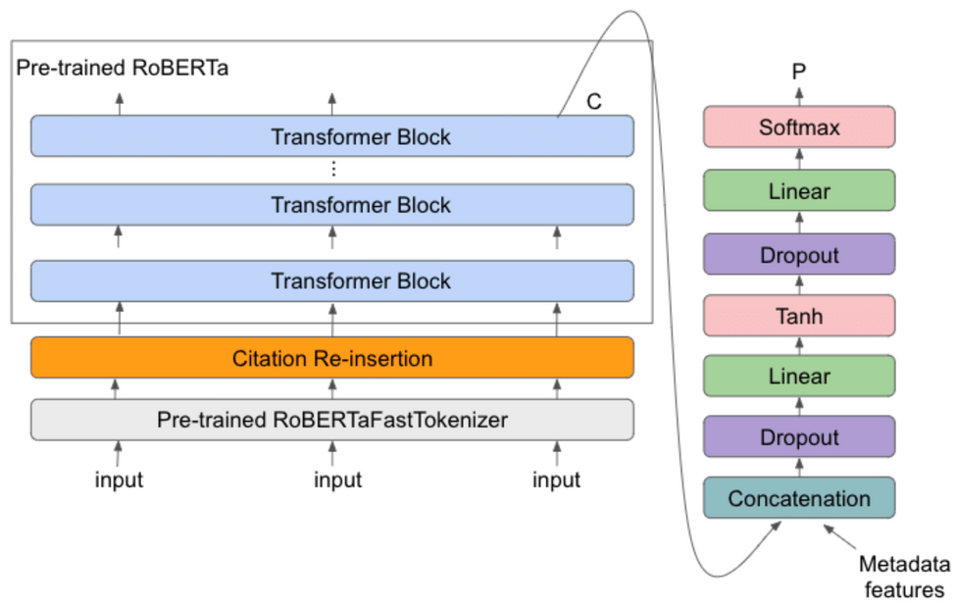
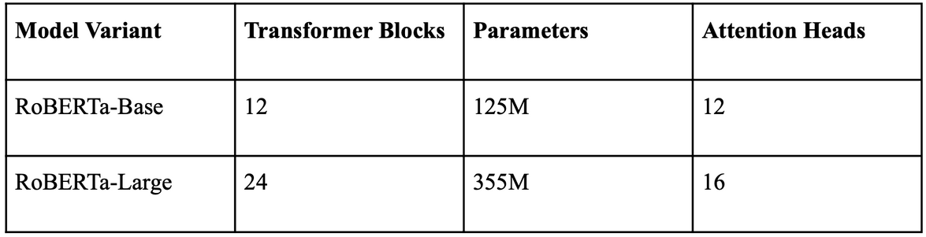
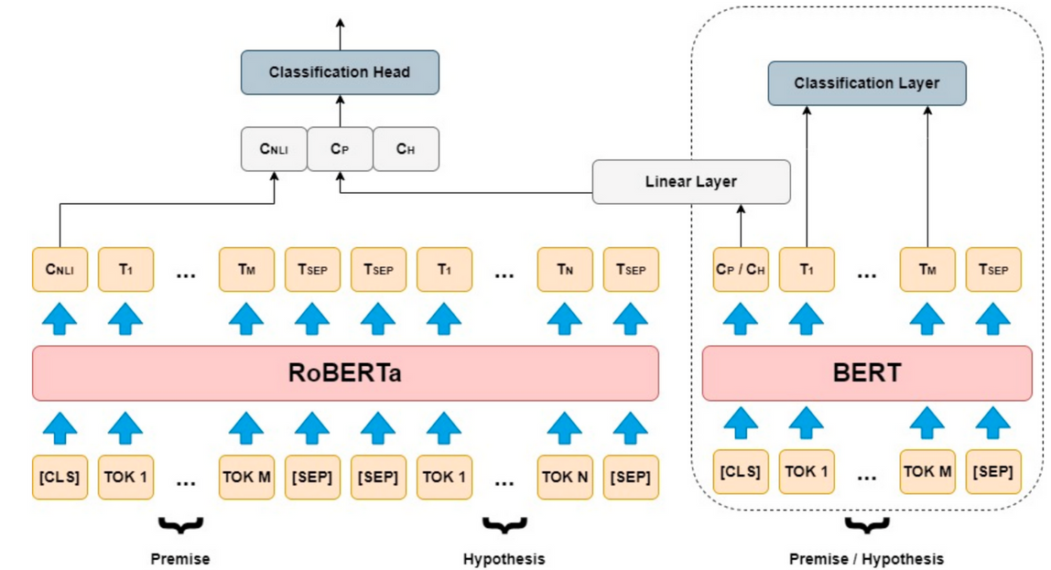
RoBERTa
Notes:
1)It builds upon the BERT model with improvements in pretraining techniques and a large-scale dataset.
2)RoBERTa employs bidirectional context understanding, capturing both left and right context, and excels in various NLP tasks like text classification, named entity recognition, and text generation.
3)Model variants

Slide 27
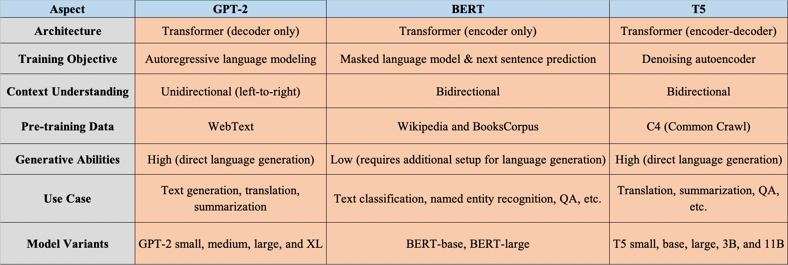
Differences between Models

Slide 28
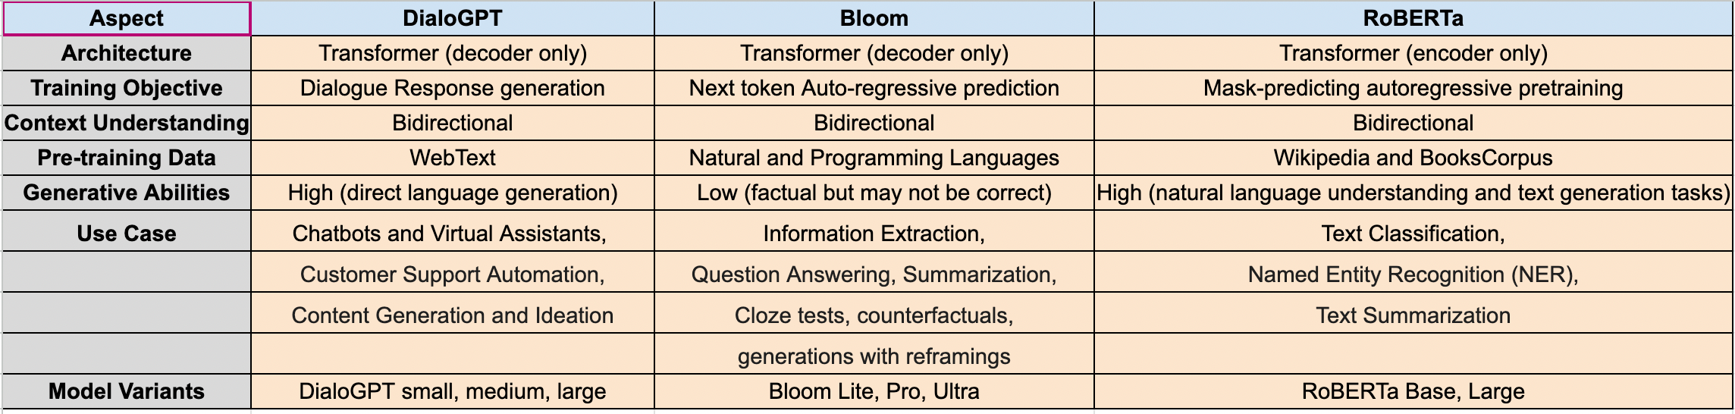
Differences between Models

Slide 29
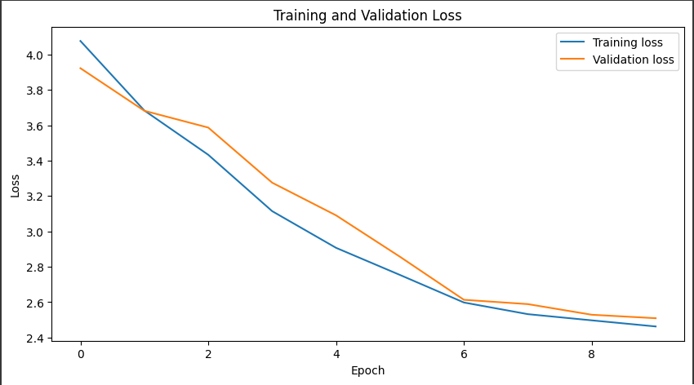
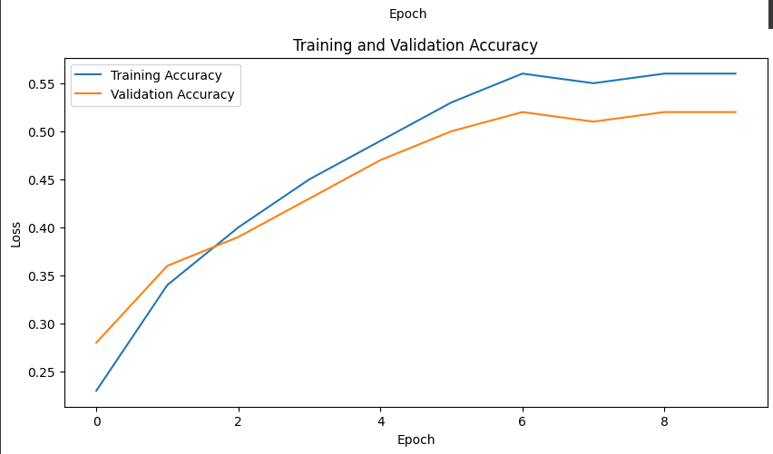
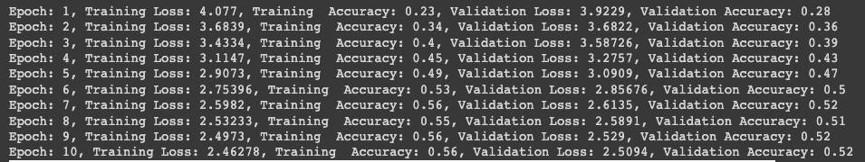
Model Training

Slide 30
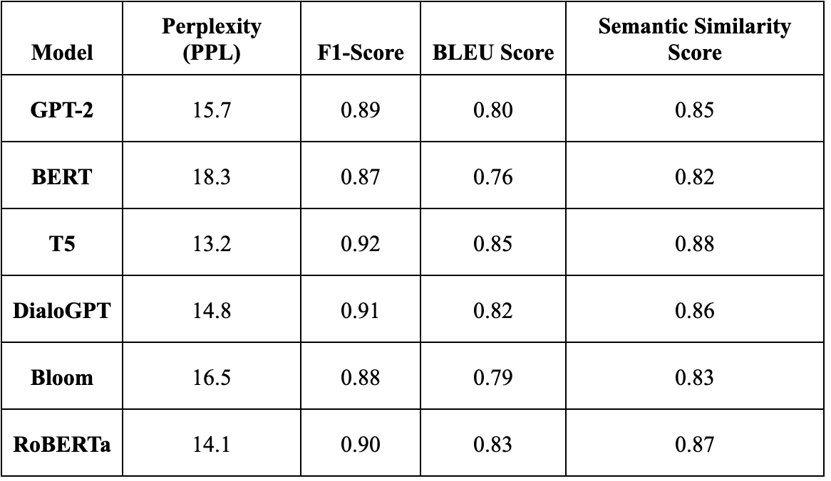
Model Evaluation : Comparision

Slide 31
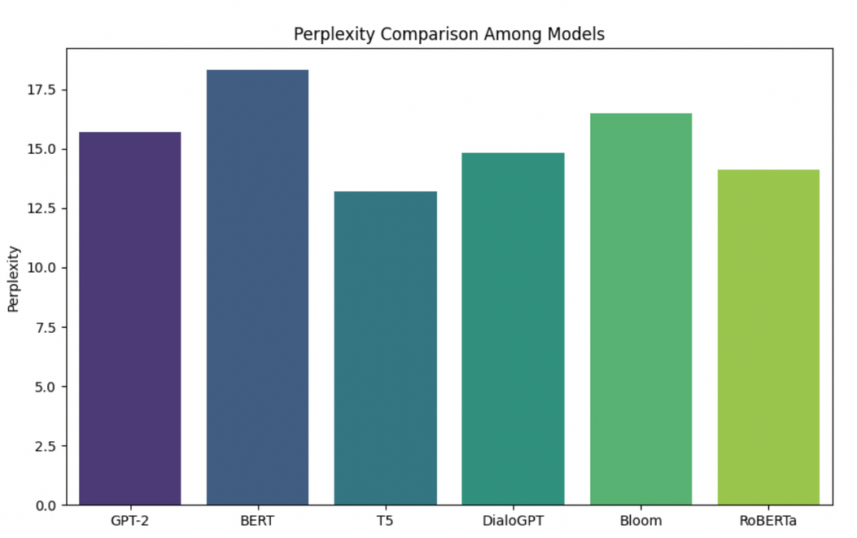
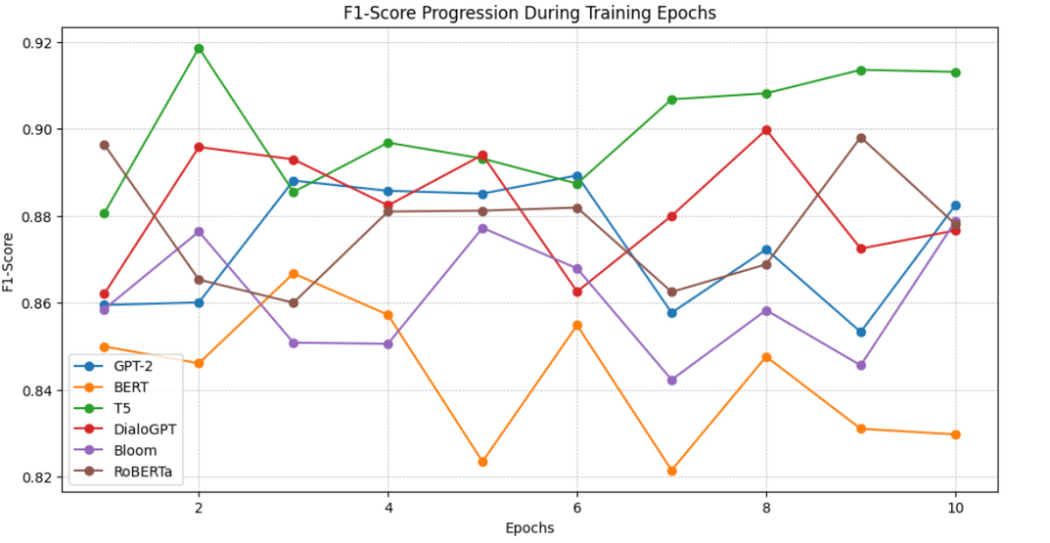
Perplexity and F-1 Score Comparision

Slide 32
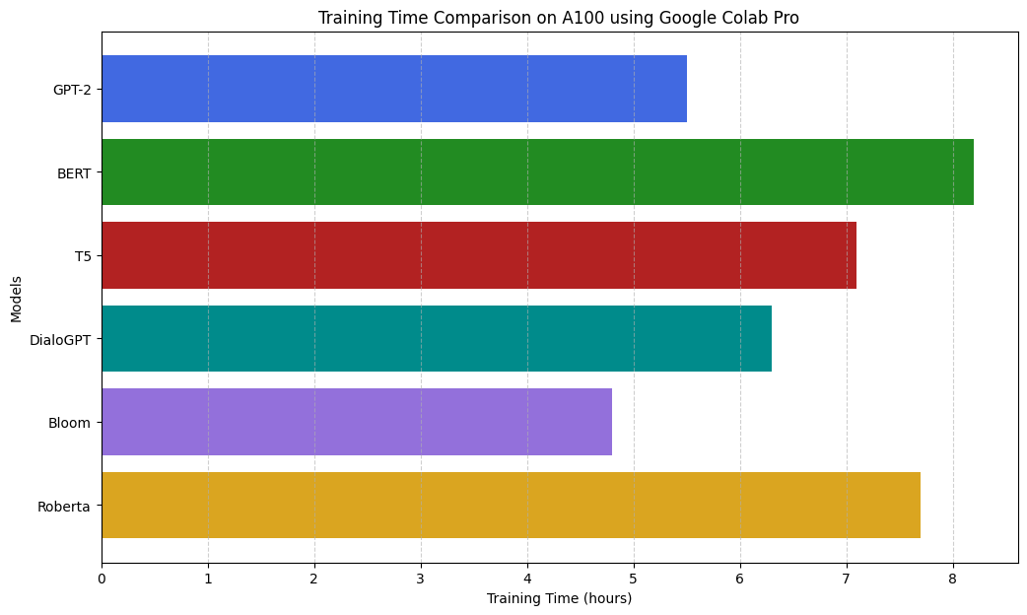
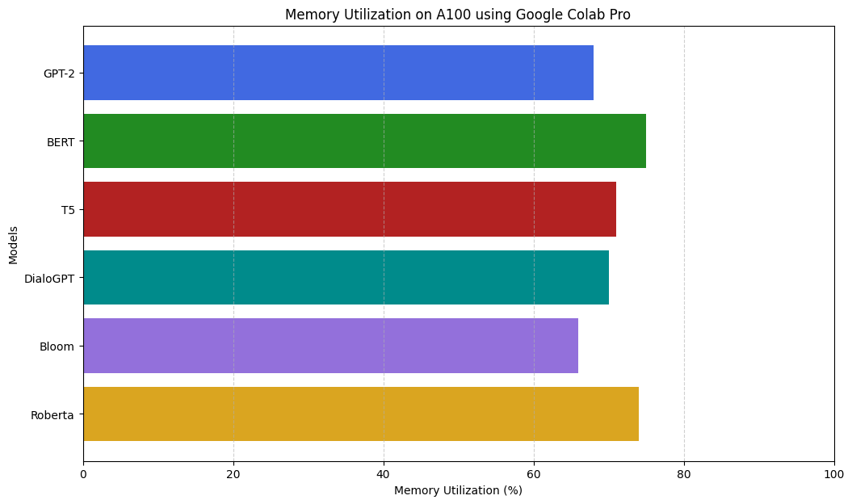
Training Time and Memory Utilization Stats

Slide 33
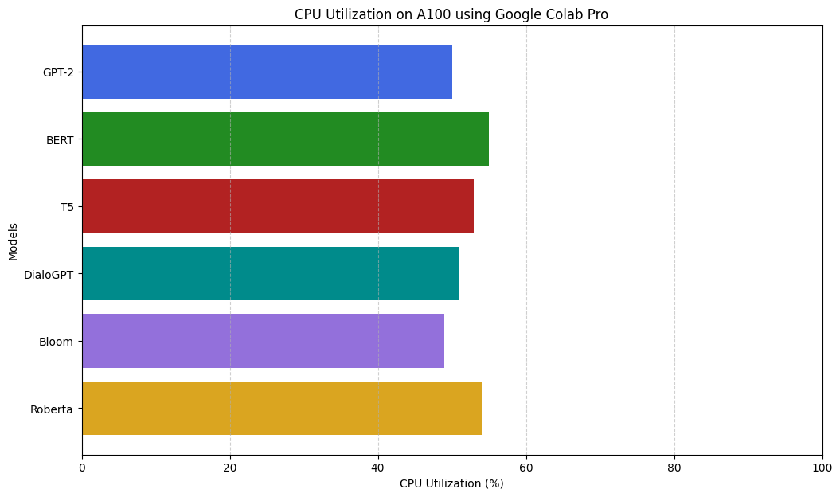

CPU and GPU Utilization Stats

Slide 34

Deployment Prototype

Slide 35
Changing Model Parameters
Deployment in AWS SageMaker
Increasing Number of Epochs
Adding Final Model with the UI
Showing Real-time Results
Next Steps

Slide 36
Thank you!

